Slide 1
Live Analysis and High Performance Computing at SNS
Pete Peterson, Mathieu Doucet, Stuart Campbell, Ross Miller
Neutron Data Analysis and Visualization
ORNL is managed by UT-Battelle, LLC,
under contract DE-AC05-00OR22725
for the U.S. Department of Energy.

Slide 2
Stated Goals
“The appropriate computational framework must be developed and implemented to enable integrating modeling, experiment and data analysis.
Rigorous sensitivity analysis is needed to understand the relationships between model predictions and experimental results, making clear the effects of model changes on predictions and enabling more effective optimization against data.”
- Center for Accelerating Materials Modeling from SNS data (CAMM) Proposal
Data
Reduction
Analysis
DAS
Data stream
Data files
Modeling/fitting
Simulation

Slide 3
Stated Goals
The ability to reduce, and analyze, the data as it is taken
Data files created instantly after acquisition
The ability to reduce a data set post-acquisition in minutes
The resources for any user to do post-acquisition reduction, analysis, visualization, modeling from anywhere

Slide 4
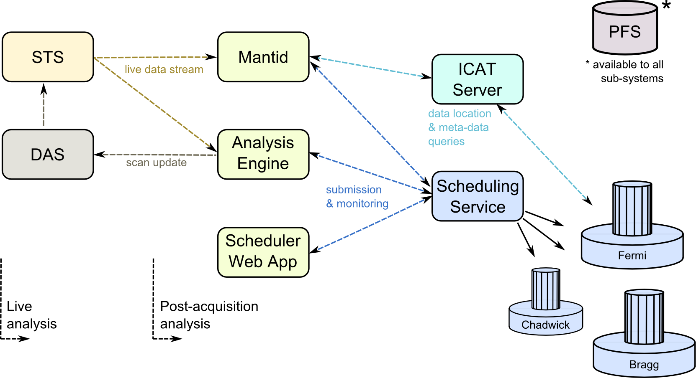
Sub-System Communication
Looking at it from the perspective of communication between sub-systems

Slide 5
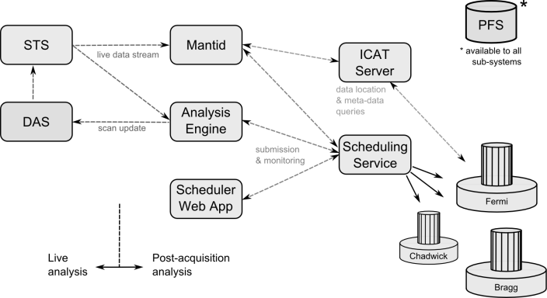
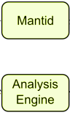
Mantid & Analysis App Communication
“Mantid app” may mean MantidPlot, apps or scripts using the Mantid framework, or scripts.
The Analysis Engine is any analysis application that can make use of data (reduced or not) and can leverage resources/libraries on the clusters.
Post-acquisition, we need those apps to:
Communicate with ICAT to locate data
Read those files from the Parallel File System
Send jobs to the scheduler
During acquisition, we also need to:
Listen to the live data stream
Those apps are the only thing that users interact with.
Live event processing with ADARA
and Mantid for HYSPEC data

Slide 6

Scheduling Service Communication
Assumption: We want to allow ourselves to have several clusters, of different types, running different local scheduling services.
We need a unified service to authenticate users, submit and monitor jobs on the clusters.
We don’t want to apps to have to pick which clusters are available and what protocol they understand.
The current thinking is to use Moab on the clusters for job management, and use its web service for communication with the scheduling service.
The scheduling service would be a web service.
A web app could also be built to allow monitoring across clusters.
The processes on the clusters (Mantid) would be responsible for making their ICAT service call.
In the short term, applications will submit jobs directly to Fermi or Chadwick through a Moab-based web service.

Slide 7
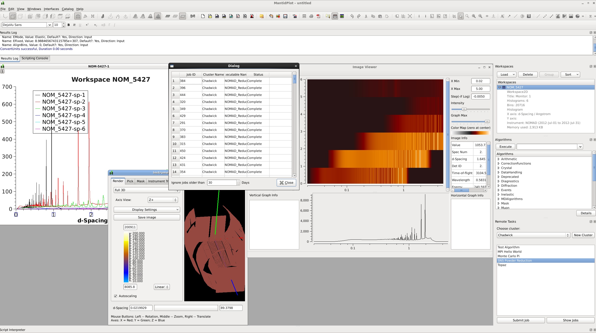
Options for Job Submission
Submission of
canned jobs
through Mantid
import fermi
def compute(data_chunk):
# Mantid reduction,
# Analysis, etc…
return
jid = fermi.map(compute, [chunk1, chunk2, chunk3])
partial_results = fermi.result(jid)
result = sum(partial_results)
Develop infrastructure
to submit custom scripts

Slide 8
Live Analysis, Experiment Decision Support, and more
Mantid is already ready to process live data streams.
One can imagine running experiment decision support apps that processes the reduced data further and returns live information to users.
Those could be Mantid algorithms or thin applications that submit reduction and analysis jobs to the clusters.
The real novelty is to communicate feedback to DAS. There are several types of feedback:
Send a Stop command after we have enough data
Submit a new scan to be started after the
current one finishes
Edit the current scan (remove/add points)
We’ll need to develop an API to communicate that feedback.
This is not hard in principle, but we also need to implement the associated logic in the DAS.
Live event processing with ADARA and Mantid for HYSPEC data

Slide 9
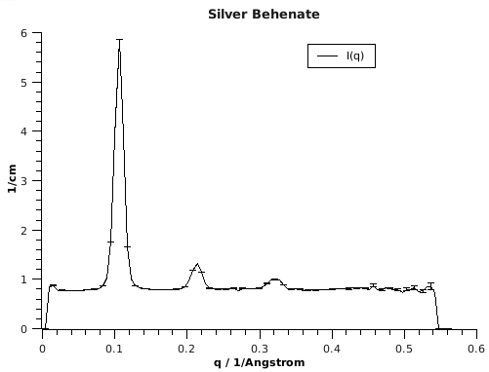
Summary
Meta-data for automated reduction
Fast disk IO
Live update
Flexible acquisition
Easy job submission
Easy monitoring
Notes:
ILL/Nomad – Scientific controller for an Analysis Engine

